Slide 1

Machine Learning
Session 2

Slide 2




Session 2
Content
Linear regression with one variable review.
cost function review.
gradient descent.
------Break------
pandas & numpy.
Appling with code.
Grow Through

Slide 3
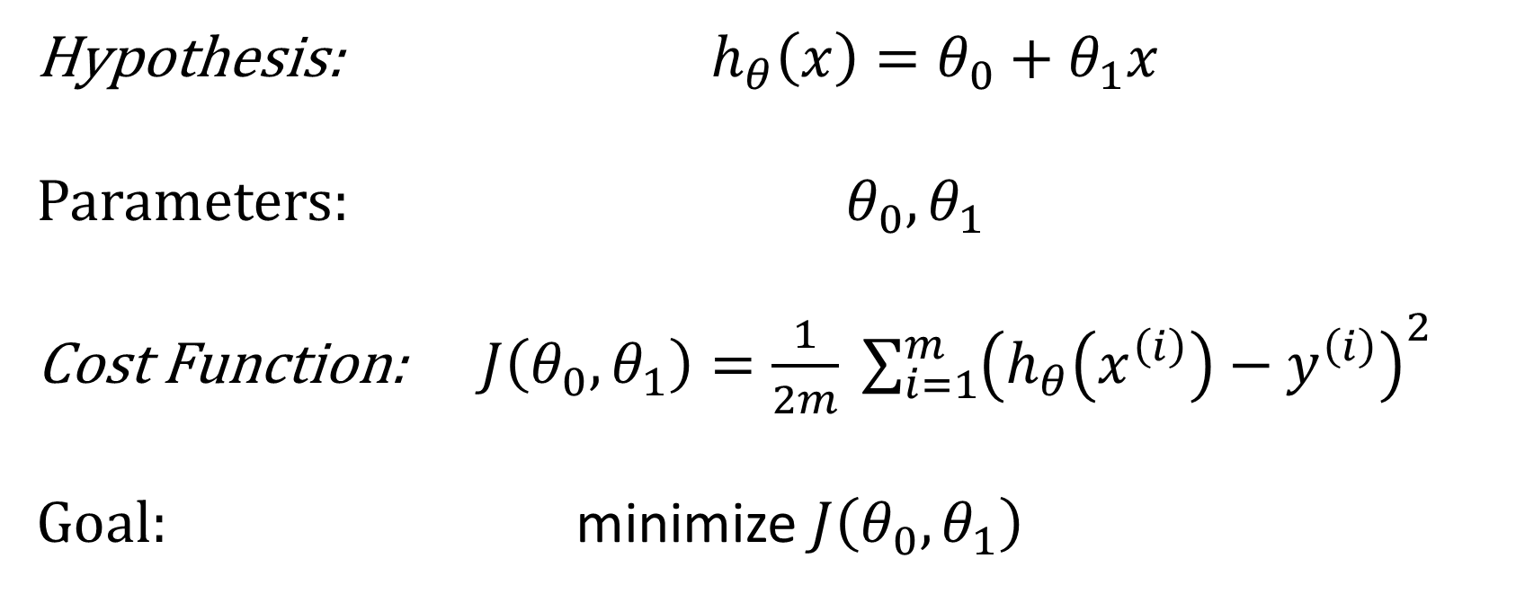
Linear Regression problem with one variable
Hypothesis: $h_{θ}\left(x\right)=θ_{0}+θ_{1}x$
Parameters: $θ_{0},θ_{1}$
Cost Function: $J\left(θ_{0},θ_{1}\right)=\frac{1}{2m} \sum_{i=1}^{m}{{\left(h_{θ}\left(x^{\left(i\right)}\right)−y^{\left(i\right)}\right)}^{2}}$
Goal: minimize $J\left(θ_{0},θ_{1}\right)$
Grow Through

Slide 4
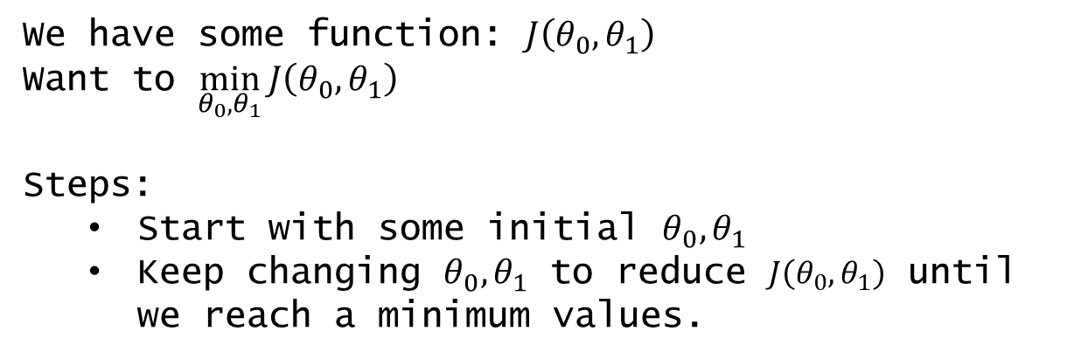
Session 2
Gradient descent
Gradient descent is a first-order iterative optimization algorithm for finding a local minimum of a differentiable function.
We have some function: $J\left(θ_{0},θ_{1}\right)$
Want to $\min_{θ_{0},θ_{1}}{J\left(θ_{0},θ_{1}\right)}$
Steps:
Start with some initial $θ_{0},θ_{1}$
Keep changing $θ_{0},θ_{1}$ to reduce $J\left(θ_{0},θ_{1}\right)$ until we reach a minimum values.
Grow Through

Slide 5
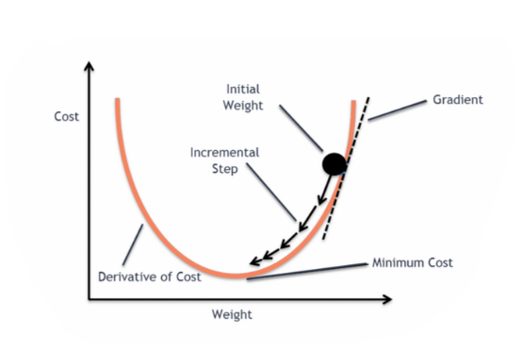
Session 2
Gradient descent
Grow Through

Slide 6
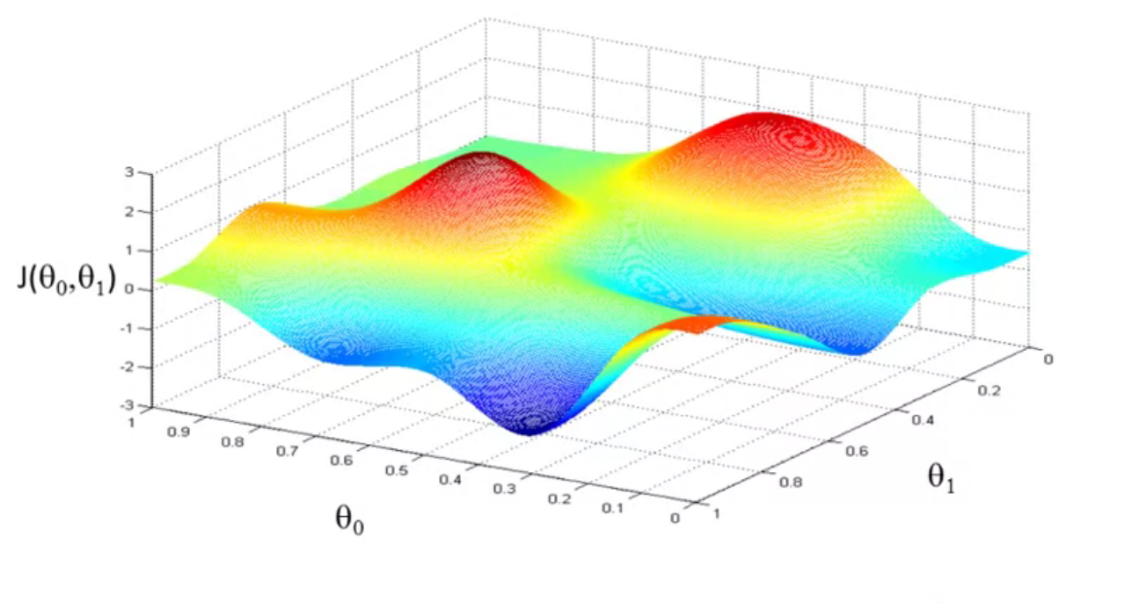
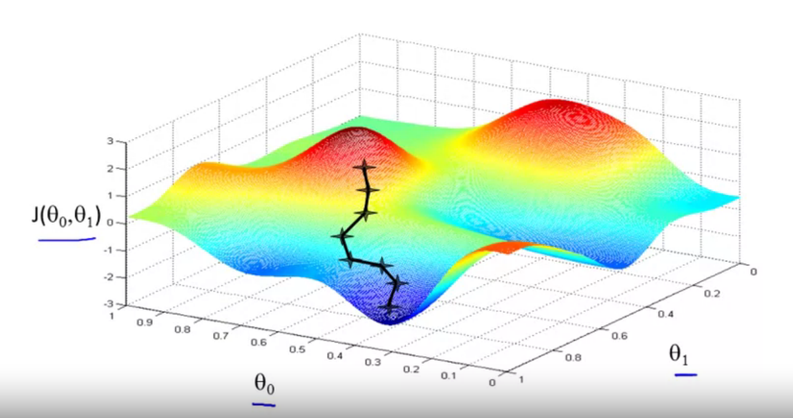
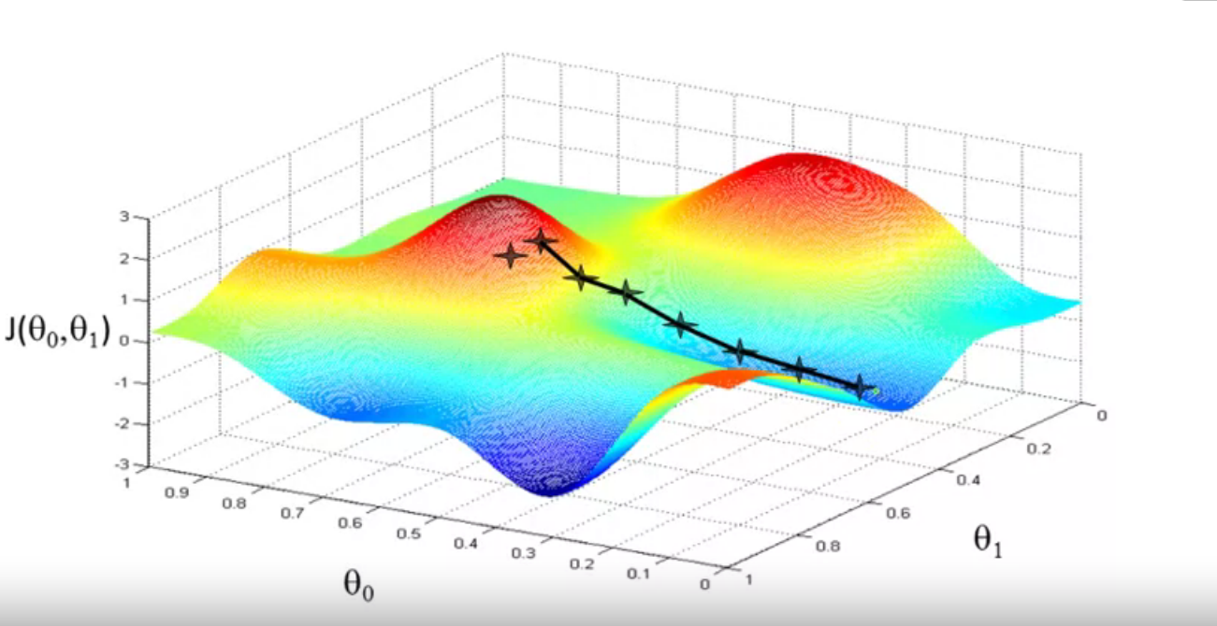
Session 2
Gradient descent
We start with an initial value then we keep changing until we reach a local minimum.
Local minimum
Grow Through

Slide 7
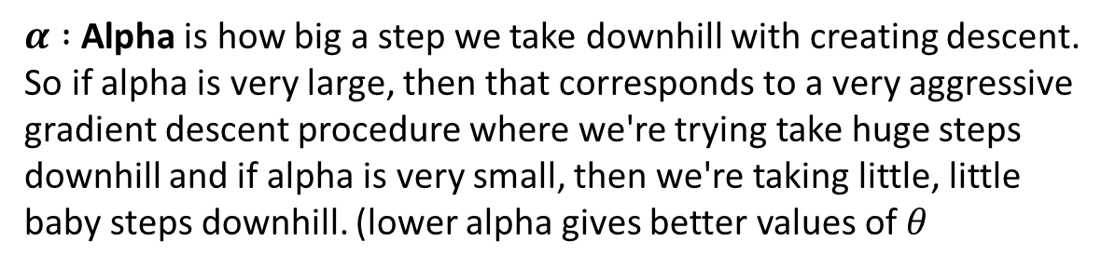
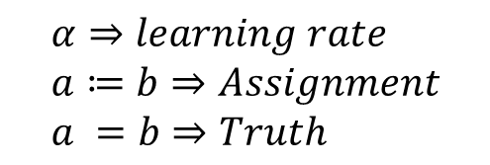
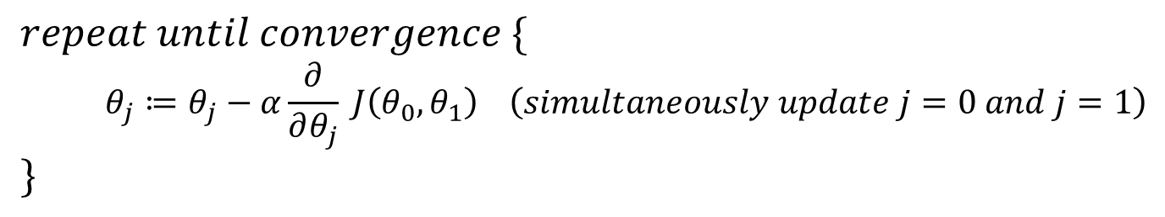
Session 2
Gradient descent algorithm
$$repeat until convergence \{ \\ θ_{j}≔θ_{j}−α\frac{∂}{∂θ_{j}} J\left(θ_{0},θ_{1}\right) \left(simultaneously update j=0 and j=1\right) \\ \}$$
$$α⇒learning rate \\ a≔b⇒Assignment \\ a =b⇒Truth$$
$α :$Alpha is how big a step we take downhill with creating descent.
So if alpha is very large, then that corresponds to a very aggressive gradient descent procedure where we're trying take huge steps downhill and if alpha is very small, then we're taking little, little baby steps downhill. (lower alpha gives better values of $θ$
Grow Through

Slide 8
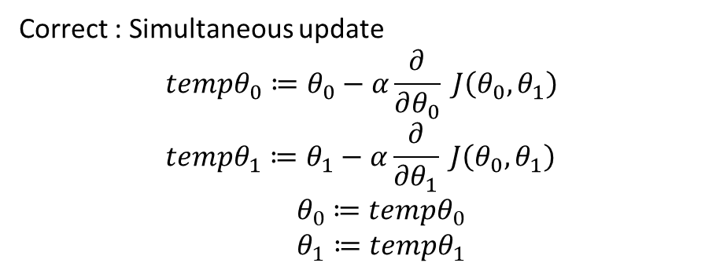
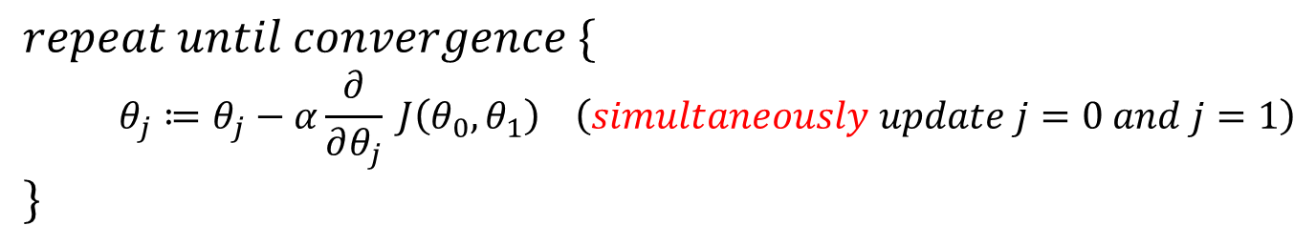
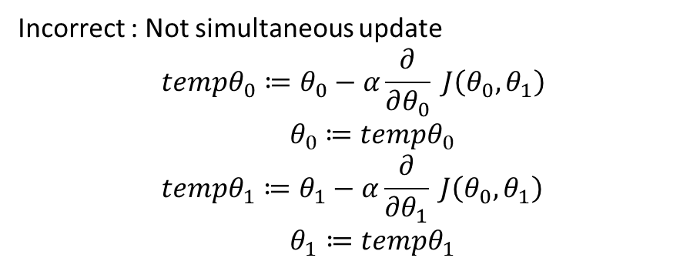
Session 2
Gradient descent algorithm
$$repeat until convergence \{ \\ θ_{j}≔θ_{j}−α\frac{∂}{∂θ_{j}} J\left(θ_{0},θ_{1}\right) \left(simultaneously update j=0 and j=1\right) \\ \}$$
$$α⇒learning rate \\ a≔b⇒Assignment \\ a =b⇒Truth$$
Correct : Simultaneous update
$$tempθ_{0}≔θ_{0}−α\frac{∂}{∂θ_{0}} J\left(θ_{0},θ_{1}\right) \\ tempθ_{1}≔θ_{1}−α\frac{∂}{∂θ_{1}} J\left(θ_{0},θ_{1}\right) \\ { θ}_{0} ≔tempθ_{0} \\ θ_{1}≔tempθ_{1}$$
Incorrect : Not simultaneous update
$$tempθ_{0}≔θ_{0}−α\frac{∂}{∂θ_{0}} J\left(θ_{0},θ_{1}\right) \\ { θ}_{0} ≔tempθ_{0} \\ tempθ_{1}≔θ_{1}−α\frac{∂}{∂θ_{1}} J\left(θ_{0},θ_{1}\right) \\ θ_{1}≔tempθ_{1}$$
Grow Through

Slide 9
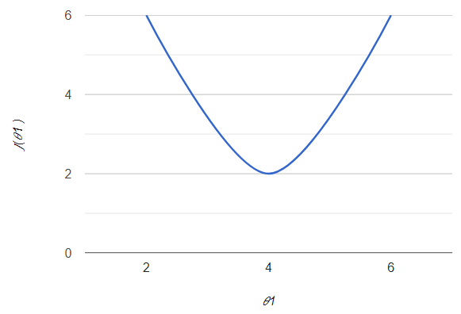

Session 2
Gradient descent
$$θ_{1}≔θ_{1}−α\frac{∂}{∂θ_{1}} J\left(θ_{0},θ_{1}\right)$$
How to reach the local minimum ?
Positive slope
$$θ_{1}≔θ_{1}−(positive number)$$
So the value of theta will keep decreasing until it reaches the local minimum
Grow Through

Slide 10

Session 2
Gradient descent
$$θ_{1}≔θ_{1}−α\frac{∂}{∂θ_{1}} J\left(θ_{0},θ_{1}\right)$$
How to reach the local minimum ?
Negative slope
$$θ_{1}≔θ_{1}−(Negative number)$$
So the value of theta will keep increasing until it reaches the local minimum
Grow Through

Slide 11



Session 2
Value of Alpha $α$?
Gradient descent
$$θ_{1}≔θ_{1}−α\frac{∂}{∂θ_{1}} J\left(θ_{0},θ_{1}\right)$$
Grow Through

Slide 12
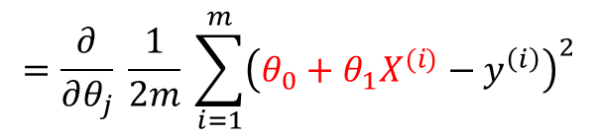
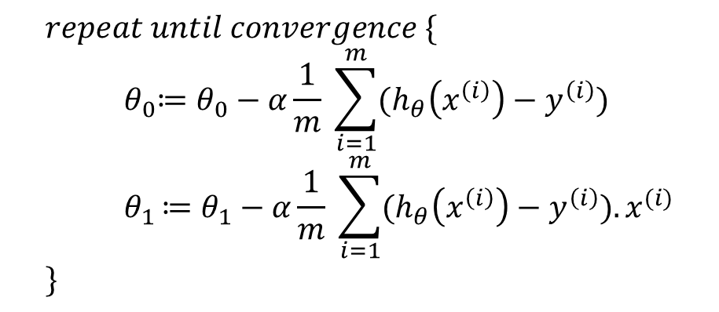
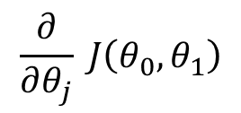
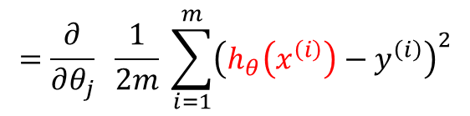
Session 2
Gradient descent equation
$$\frac{∂}{∂θ_{j}} J\left(θ_{0},θ_{1}\right)$$
$$=\frac{∂}{∂θ_{j}} \frac{1}{2m} \sum_{i=1}^{m}{{\left(h_{θ}\left(x^{\left(i\right)}\right)−y^{\left(i\right)}\right)}^{2}}$$
$$=\frac{∂}{∂θ_{j}} \frac{1}{2m} \sum_{i=1}^{m}{{\left(θ_{0}+θ_{1}X^{(i)}−y^{\left(i\right)}\right)}^{2}}$$
$$repeat until convergence \{ \\ { θ}_{0}≔θ_{0}−α\frac{1}{m} \sum_{i=1}^{m}{(h_{θ}\left(x^{\left(i\right)}\right)−y^{\left(i\right)})} \\ { θ}_{1 }≔θ_{1}−α\frac{1}{m} \sum_{i=1}^{m}{(h_{θ}\left(x^{\left(i\right)}\right)−y^{\left(i\right)}).x^{(i)}} \\ \}$$
Grow Through

Slide 13
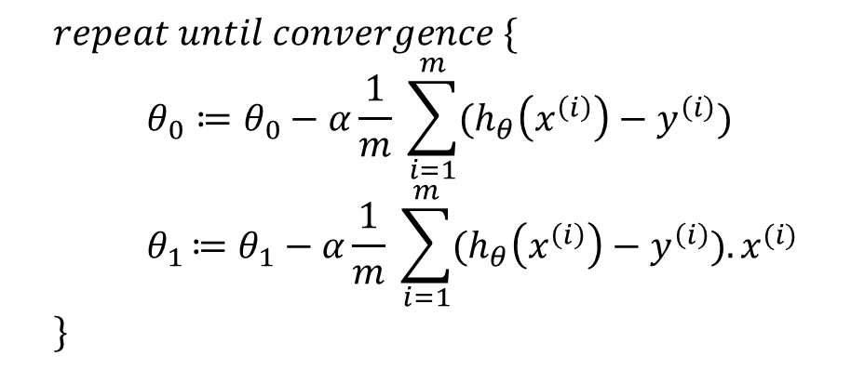
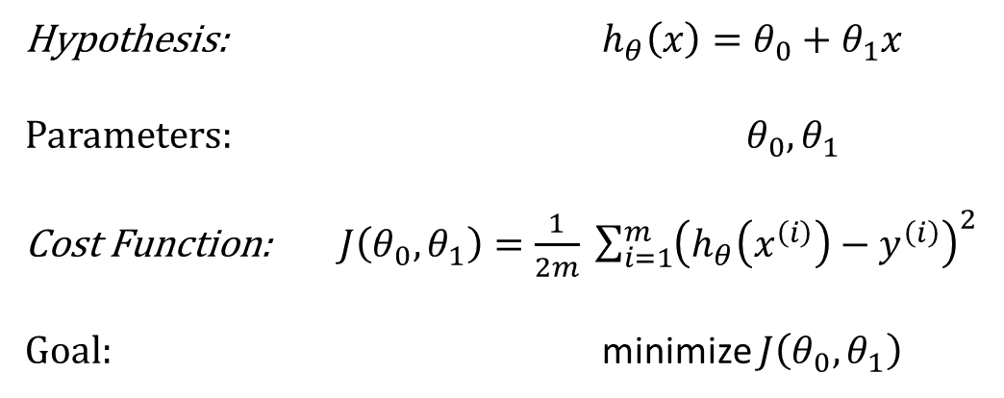
Session 2
All Equations:
Linear regression model
Gradient descent algorithm
Hypothesis: $h_{θ}\left(x\right)=θ_{0}+θ_{1}x$
Parameters: $θ_{0},θ_{1}$
Cost Function: $J\left(θ_{0},θ_{1}\right)=\frac{1}{2m} \sum_{i=1}^{m}{{\left(h_{θ}\left(x^{\left(i\right)}\right)−y^{\left(i\right)}\right)}^{2}}$
Goal: minimize $J\left(θ_{0},θ_{1}\right)$
$$repeat until convergence \{ \\ θ_{0}≔θ_{0}−α\frac{1}{m} \sum_{i=1}^{m}{(h_{θ}\left(x^{\left(i\right)}\right)−y^{\left(i\right)})} \\ { θ}_{1 }≔θ_{1}−α\frac{1}{m} \sum_{i=1}^{m}{(h_{θ}\left(x^{\left(i\right)}\right)−y^{\left(i\right)}).x^{(i)}} \\ \}$$
Grow Through

Slide 14
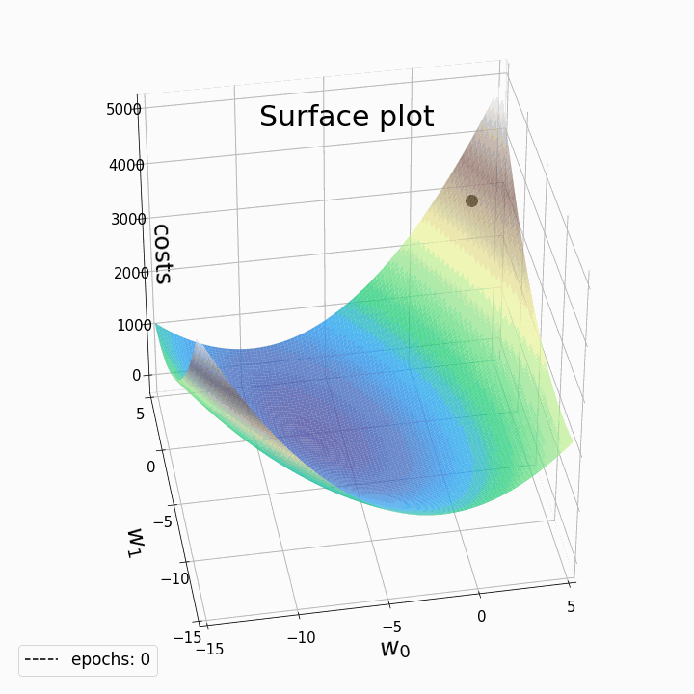
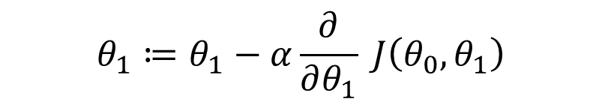
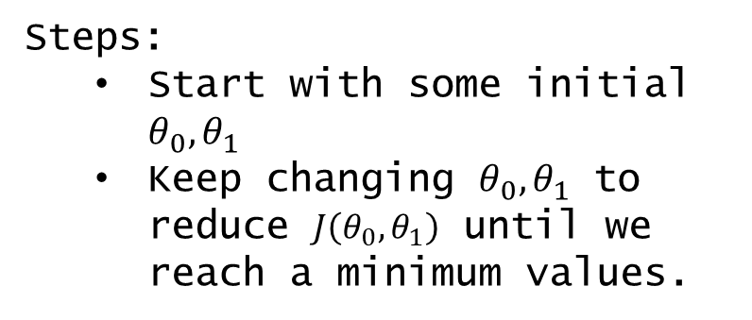
Session 2
Gradient descent
$$θ_{1}≔θ_{1}−α\frac{∂}{∂θ_{1}} J\left(θ_{0},θ_{1}\right)$$
Steps:
Start with some initial $θ_{0},θ_{1}$
Keep changing $θ_{0},θ_{1}$ to reduce $J\left(θ_{0},θ_{1}\right)$ until we reach a minimum values.
Note :
“Batch”: Each step of Gradient descent uses all the training examples.
Grow Through

Slide 15

Session 2
Gradient descent
Grow Through

Slide 16
Goodbye
Grow Through

